Slide 1
Colorectal Cancer:
Public Health Surveillance Data & Trends
Gale Burstein, MD, MPH, FAAP
September 19, 2026

Slide 2
Colorectal CANCER AT A GLANCE
Colorectal Cancer | Burden Data
Estimated new cases, 2026 | Estimated deaths, 2026 | Incidence rates, 2018-2022 | Death rates, 2019-2023
158,850 | 55,230 | 37.2 | 12.9
 |  | Average annual rate per 100,000, age adjusted to the 2000 U.S. standard population
American Cancer Society. Cancer Statistics Center. http://cancerstatisticscenter.cancer.org. Accessed 3/18/2025.

Slide 3
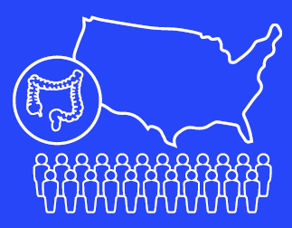



U.S. Colorectal Cancer Stats
Over the past 10 years, rates in people younger than age 50 have gone up by about 2% each year.
1 in 5
CRC cases in people under age 55
1 in 3
With CRC have a family history
1 in 5
45-49-year-olds are up-to-date on CRC screening
American Cancer Society. Cancer Facts & Figures 2024. Atlanta: American Cancer Society; 2024.
Notes:
While overall rates of colorectal cancer have gone down over the past 10 years, rates in people younger than age 50 have gone up by about 2% each year.
- 1 in 3 people who get colorectal cancer have a family history. They’re also more likely to get colorectal cancer as an earlier age

Slide 4


Colorectal cancer trends
~About 90% colorectal cancer cases are diagnosed at age 50+
Age 50+ CRC rates decreasing
Age <50 CRC rates increasing by 3.5% per year over past decade
Deaths of celebrities Chadwick Boseman, who died at age 43 in 2020, and James Van Der Beek, who died at age 48 in 2026, brought attention to growing number of adults under age 50 diagnosed with colorectal cancer.
Credit: Gage Skidmore via Wikipedia
Creative Commons via Wikipedia

Slide 5

Certain communities are at higher risk.
American Indian and Alaska Native people have the highest rates of colorectal cancer in the US.
Black individuals have the second-highest rates of colorectal cancer and are most likely to be diagnosed at a later stage, when the cancer as spread to other parts of the body.
Colorectal cancer rates of new cases are highest in West Virginia, Kentucky, Arkansas, Mississippi, and Louisiana.
American Cancer Society. Cancer Facts & Figures 2024. Atlanta: American Cancer Society; 2024.

Slide 6
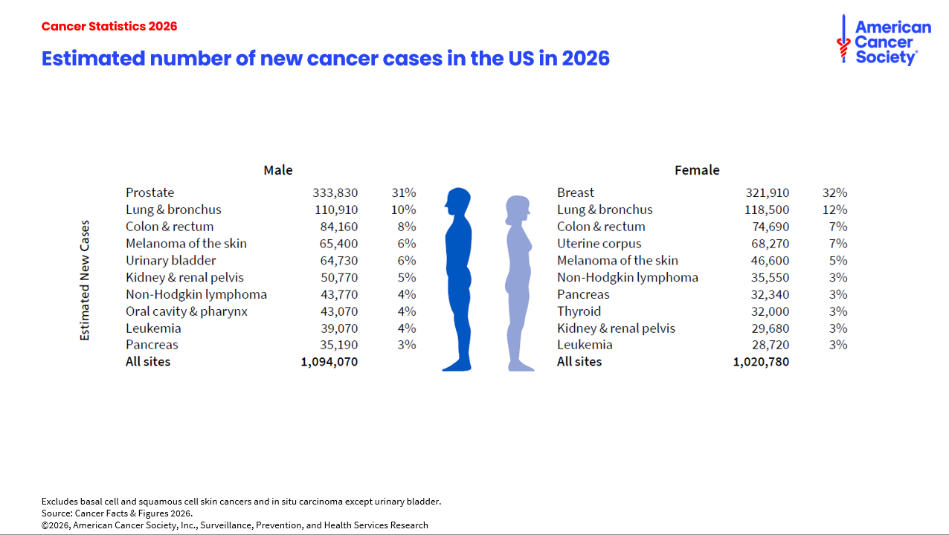
Notes:
In 2026, about 2.1 million new cancer cases are expected to be diagnosed in the United States. Prostate cancer is the most common cancer among males (31%), followed by lung (10%) and colorectal (8%) cancers. Among females, breast (32%), lung (12%), and colorectal (7%) cancers are the most common.

Slide 7

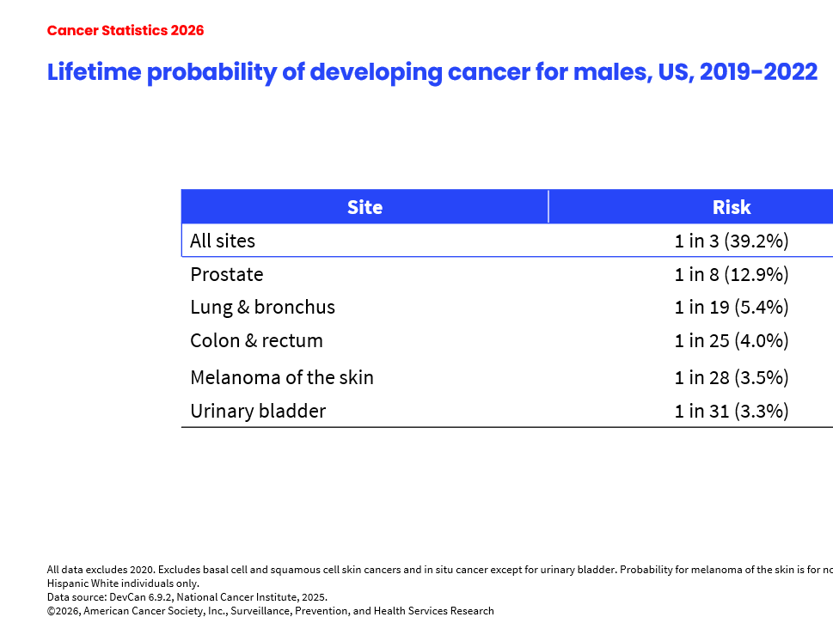


Slide 8
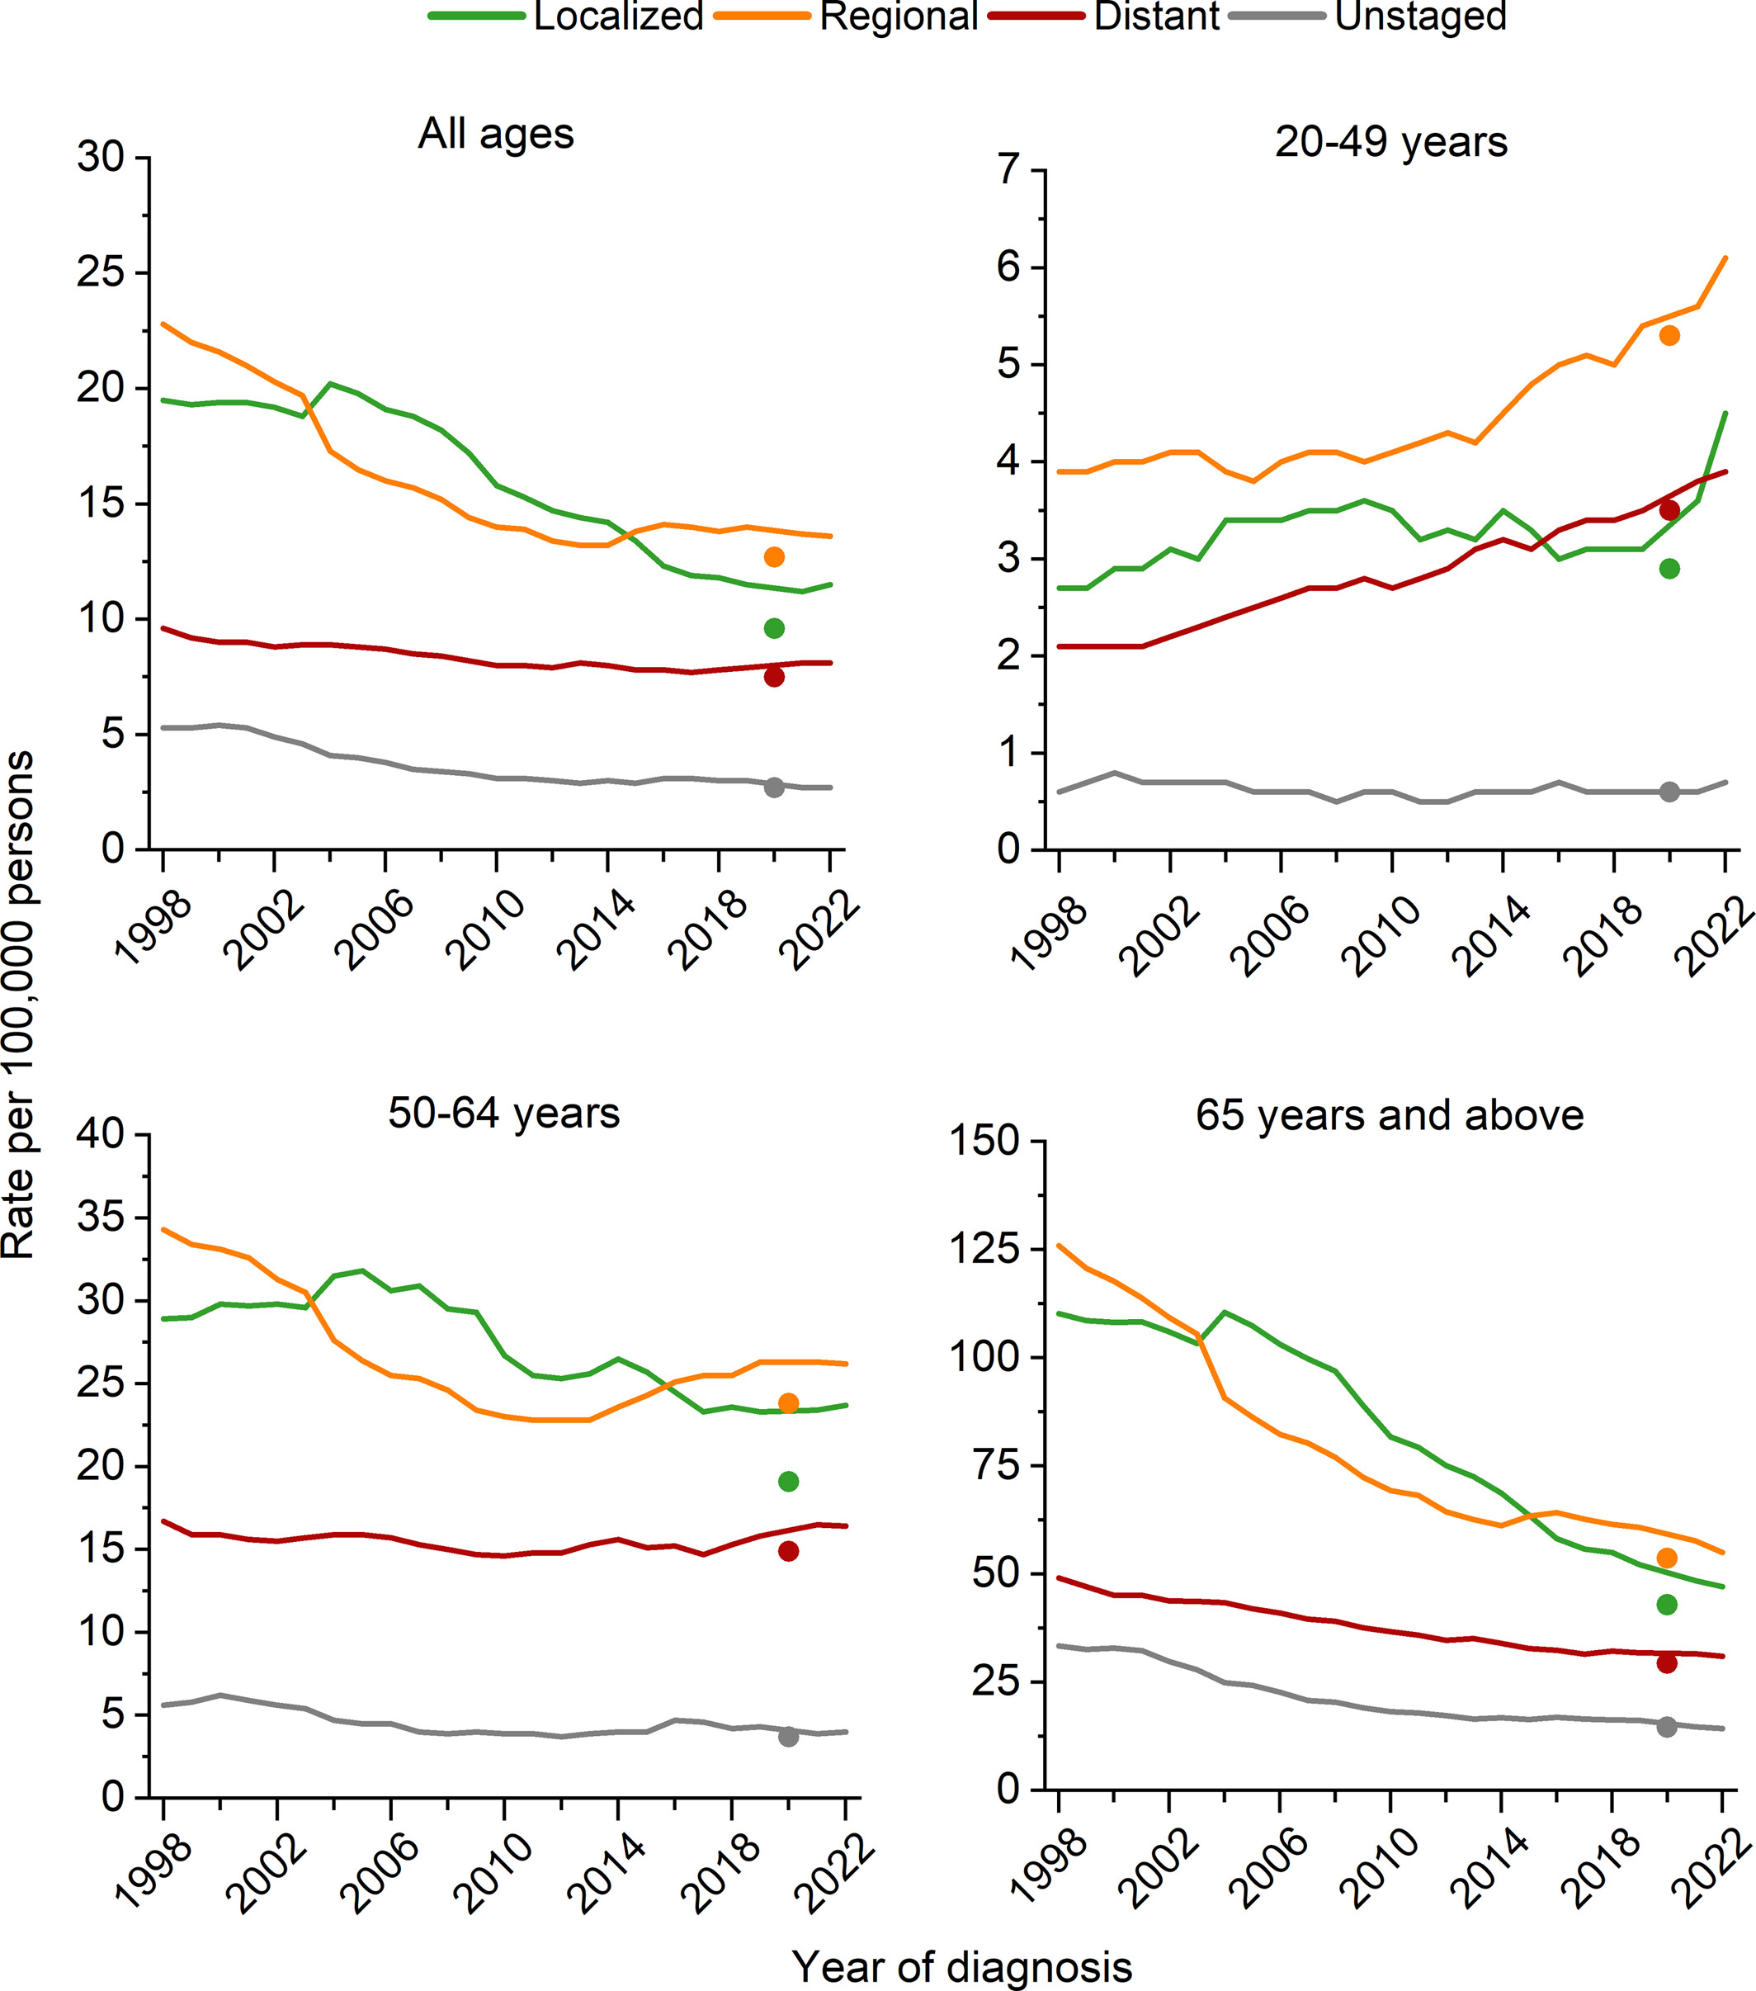
Age-specific colorectal cancer incidence rates, 1998 versus 2022, U.S.
Colorectal cancer statistics, 2026
CA A Cancer J Clinicians, Volume: 76, Issue: 2, First published: 02 March 2026, DOI: (10.3322/caac.70067)
Notes:
Trends in colorectal cancer incidence rates by age and stage at diagnosis, 1998–2022, United States. Incidence rates exclude appendiceal cancer, are age adjusted to the 2000 US standard population, and are adjusted for delays in case reporting. Incidence data for 2020 are shown separate from trend lines.
IF THIS IMAGE HAS BEEN PROVIDED BY OR IS OWNED BY A THIRD PARTY, AS INDICATED IN THE CAPTION LINE, THEN FURTHER PERMISSION MAY BE NEEDED BEFORE ANY FURTHER USE. PLEASE CONTACT WILEY'S PERMISSIONS DEPARTMENT ON PERMISSIONS@WILEY.COM OR USE THE RIGHTSLINK SERVICE BY CLICKING ON THE 'REQUEST PERMISSIONS' LINK ACCOMPANYING THIS ARTICLE. WILEY OR AUTHOR OWNED IMAGES MAY BE USED FOR NON-COMMERCIAL PURPOSES, SUBJECT TO PROPER CITATION OF THE ARTICLE, AUTHOR, AND PUBLISHER.

Slide 9
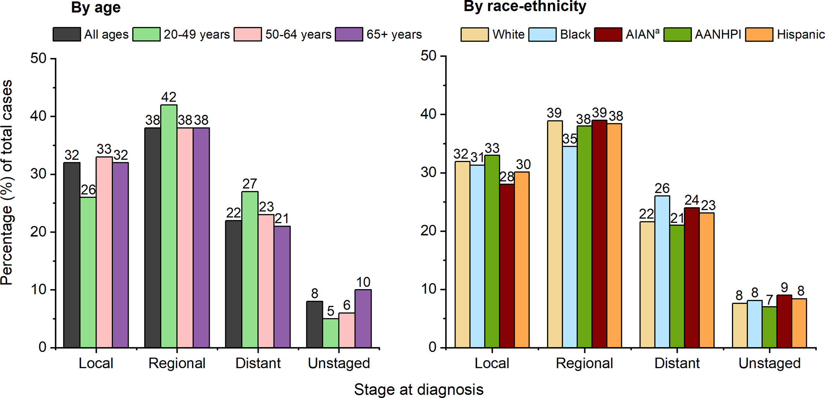
Colorectal cancer stage distribution (%) by age, race, and ethnicity, 2018–2022, U.S.
Colorectal cancer statistics, 2026
CA A Cancer J Clinicians, Volume: 76, Issue: 2, First published: 02 March 2026, DOI: (10.3322/caac.70067)
Notes:
Colorectal cancer stage distribution (%) by age, race, and ethnicity, 2018–2022, United States. Stage distribution excludes appendiceal cancer. Individual race categories are exclusive of Hispanic ethnicity. aLimited to Purchased/Referred Care Delivery Area counties. AANHPI indicates Asian American, Native Hawaiian, and other Pacific Islander; AIAN, American Indian, Alaska Native.
IF THIS IMAGE HAS BEEN PROVIDED BY OR IS OWNED BY A THIRD PARTY, AS INDICATED IN THE CAPTION LINE, THEN FURTHER PERMISSION MAY BE NEEDED BEFORE ANY FURTHER USE. PLEASE CONTACT WILEY'S PERMISSIONS DEPARTMENT ON PERMISSIONS@WILEY.COM OR USE THE RIGHTSLINK SERVICE BY CLICKING ON THE 'REQUEST PERMISSIONS' LINK ACCOMPANYING THIS ARTICLE. WILEY OR AUTHOR OWNED IMAGES MAY BE USED FOR NON-COMMERCIAL PURPOSES, SUBJECT TO PROPER CITATION OF THE ARTICLE, AUTHOR, AND PUBLISHER.

Slide 10
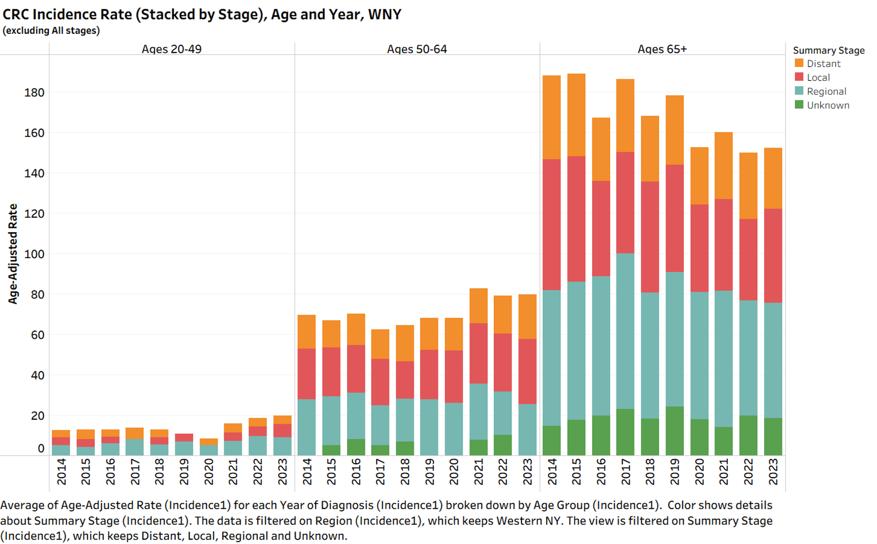

Slide 11
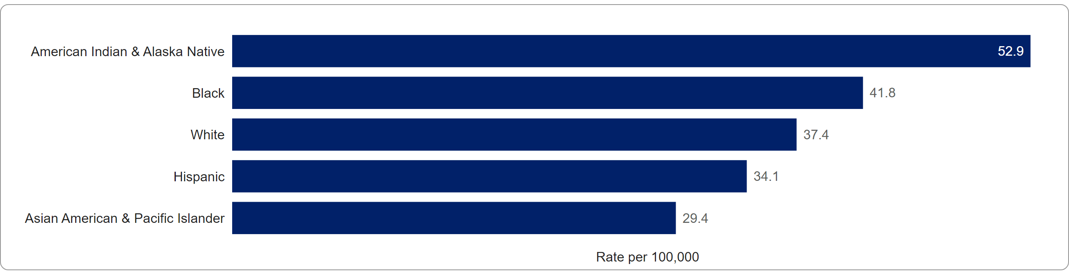
Colorectal Cancer Incidence Rates by Race & Ethnicity
Incidence Rates, 2018 - 2022
©American Cancer Society, 2026. Rates per 100,000, age-adjusted to 2000 US standard population. Incidence is adjusted for delays when possible. Race is exclusive of Hispanic origin. Data source: incidence) North American Association of Central Cancer Registries, 2025. mortality: National Center for Health Statistics, Centers for Disease Control and Prevention, 2025.
Colorectum incidence excludes appendix. Kansas rates are not adjusted for delay in case reporting. Rates for American Indian & Alaska Native people are adjusted for misclassification
SOURCE: American Cancer Society. Cancer Statistics Center. https://cancerstatisticscenter.cancer.org/ | Accessed 1/20/2026

Slide 12
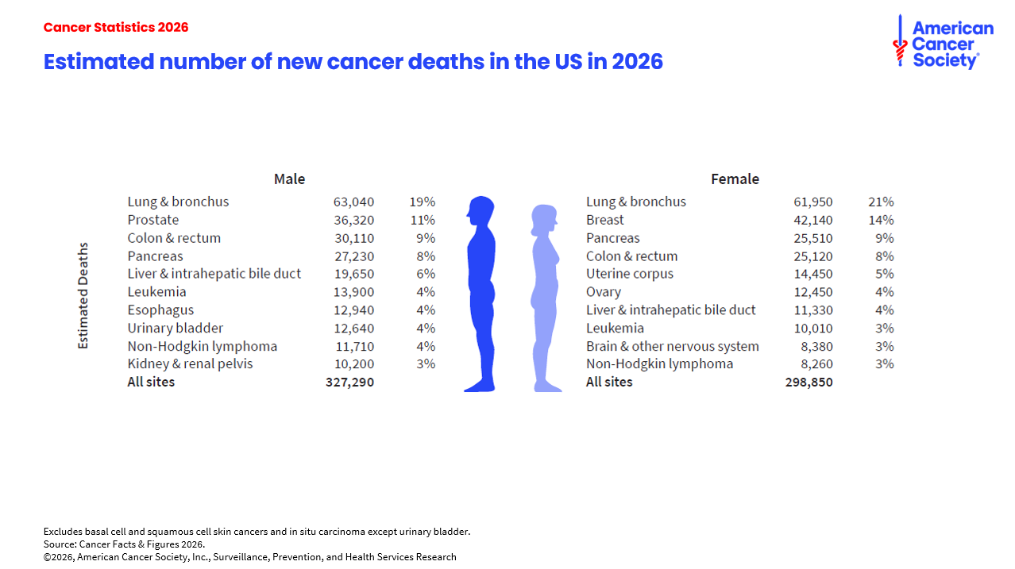
Notes:
In 2026, 626,140 deaths from cancer are expected in the United States. Lung cancer is the leading cause of cancer death among males (19%), followed by prostate (11%) and colorectal (9%) cancers. Among females, lung (21%), breast (14%), and pancreatic (9%) cancers are the leading causes of cancer death.

Slide 13
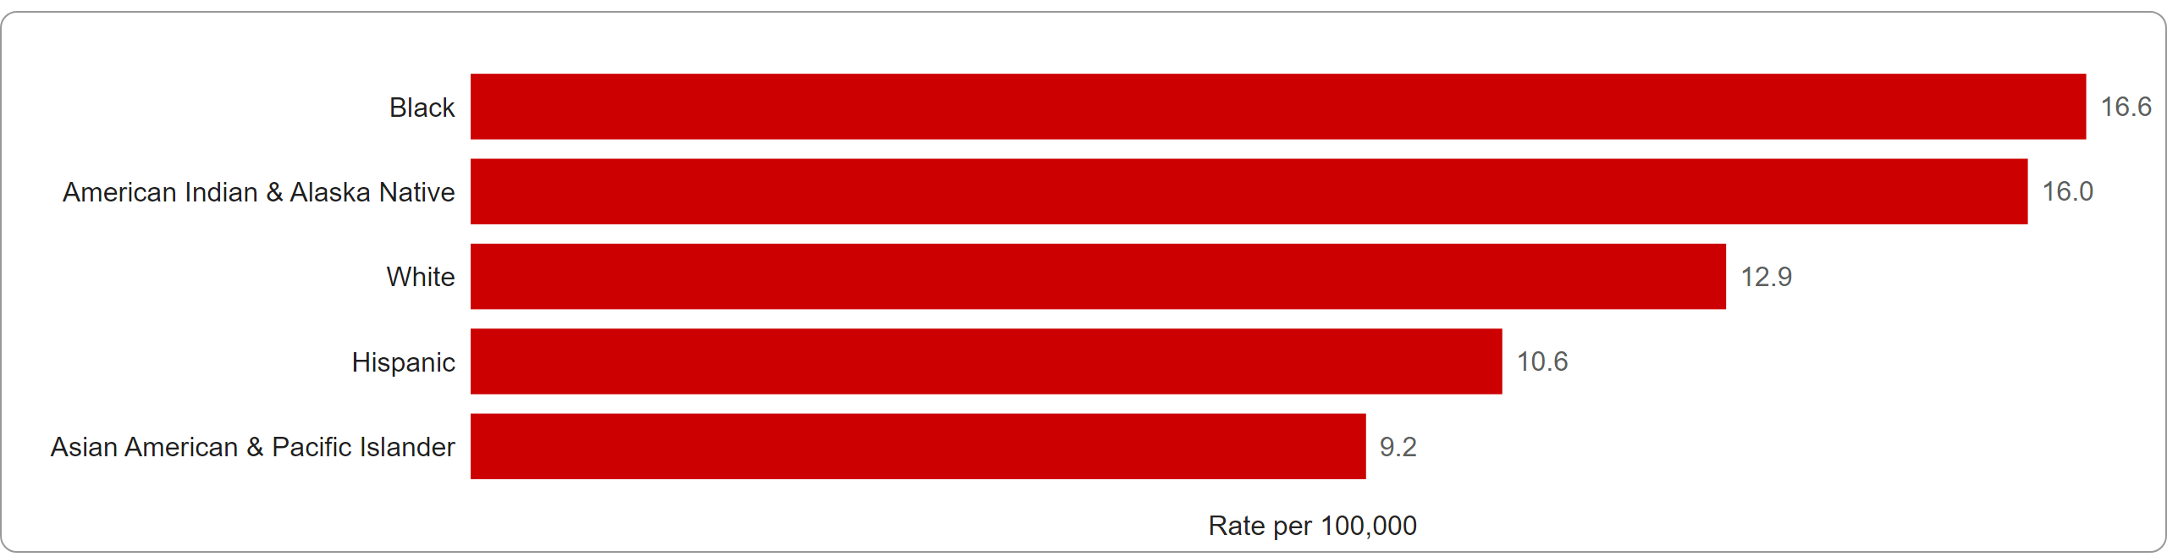
Colorectal Cancer Mortality Rates by Race & Ethnicity
Mortality Rates, 2019 - 2023
©American Cancer Society, 2026. Rates per 100,000, age-adjusted to 2000 US standard population. Incidence is adjusted for delays when possible. Race is exclusive of Hispanic origin. Data source: incidence) North American Association of Central Cancer Registries, 2025. mortality: National Center for Health Statistics, Centers for Disease Control and Prevention, 2025.
Colorectum incidence excludes appendix. Kansas rates are not adjusted for delay in case reporting. Rates for American Indian & Alaska Native people are adjusted for misclassification
SOURCE: American Cancer Society. Cancer Statistics Center. https://cancerstatisticscenter.cancer.org/ | Accessed 1/20/2026

Slide 14
Cancer Mortality Before Age 50 Years
Recent study found that deaths from most leading cancer types decreased in people< 50 years in Canada.
Most prominent reduction seen in lung and breast cancer deaths
  Lung cancer decrease associated with effective public health anti-smoking campaigns
  Breast cancer decrease associated with increased screening access, earlier detection, and better personalized treatment.
Colorectal cancer deaths increased in past 25 years, with increasing trend in early-onset incidence.
  Suggests possible generational change in etiology, such as higher prevalence in obesity and metabolic syndromes or increased exposure to unhealthy lifestyles and toxins rather than changes in diagnostic practice.

Slide 15
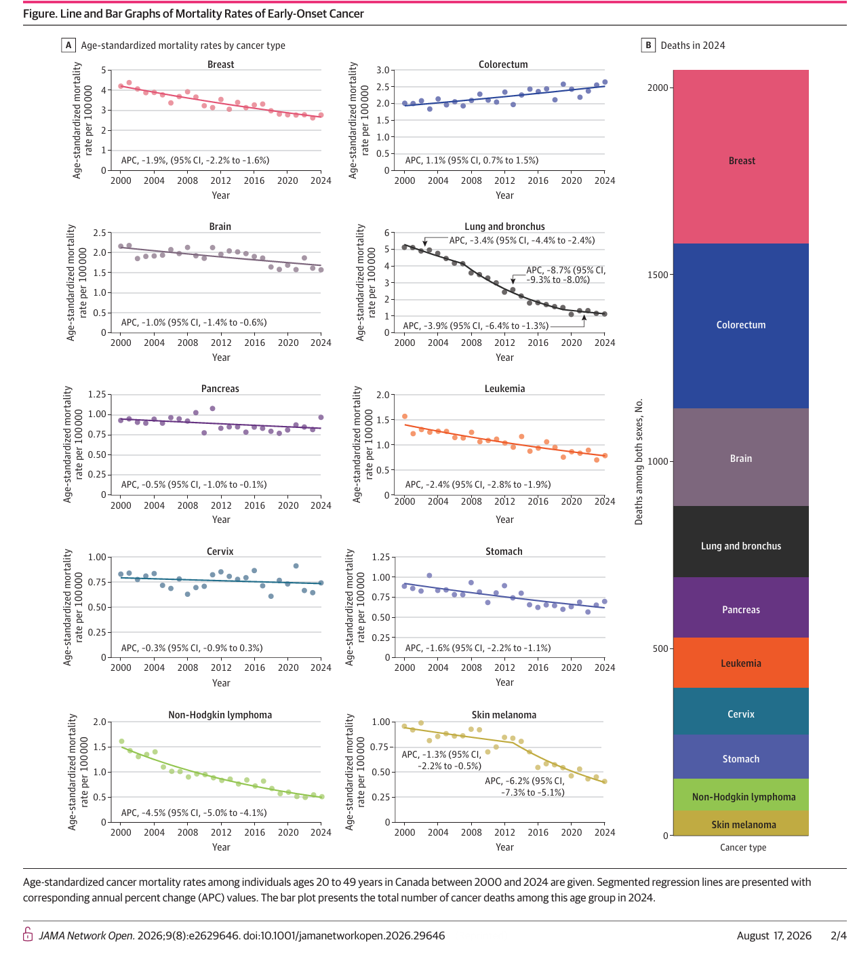
Mortality Rates for Early-Onset Cancers

Slide 16
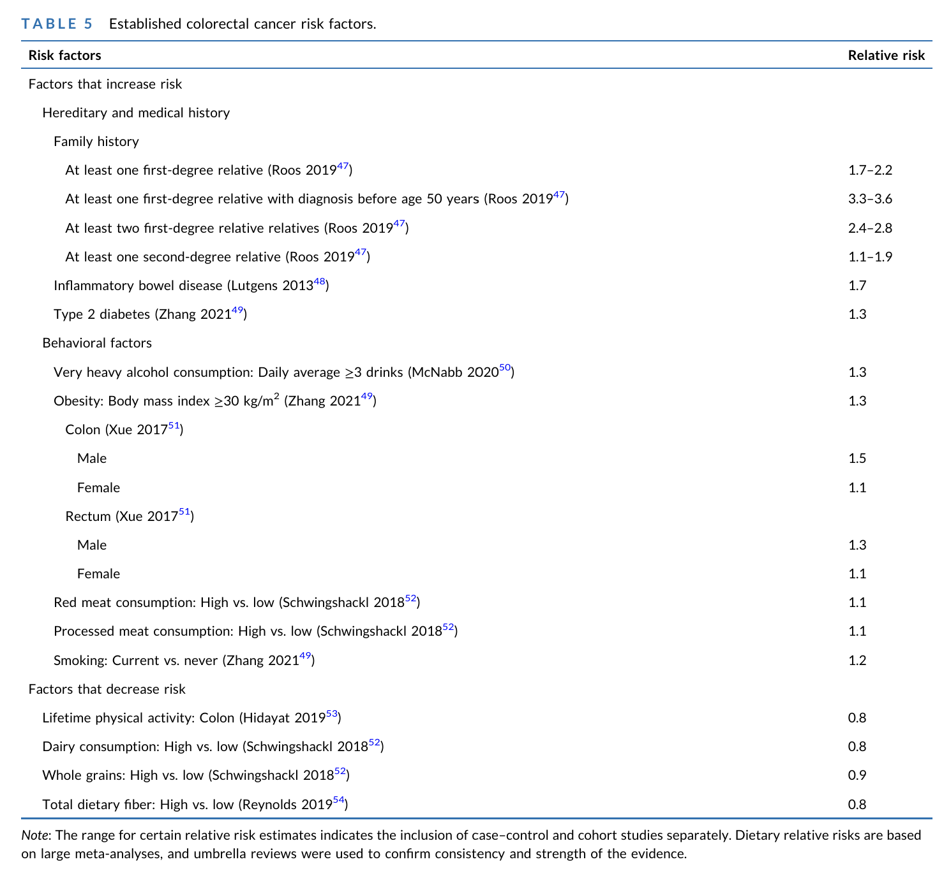
that cannot change
Colorectal cancer statistics, 2026
CA A Cancer J Clinicians, Volume: 76, Issue: 2, First published: 02 March 2026, DOI: (10.3322/caac.70067)

Slide 17
that could change
Colorectal cancer statistics, 2026
CA A Cancer J Clinicians, Volume: 76, Issue: 2, First published: 02 March 2026, DOI: (10.3322/caac.70067)

Slide 18
that decrease risk that can change
Colorectal cancer statistics, 2026
CA A Cancer J Clinicians, Volume: 76, Issue: 2, First published: 02 March 2026, DOI: (10.3322/caac.70067)

Slide 19
Colorectal Cancer Screening Data
American Cancer Society’s Cancer Prevention & Early Detection Facts & Figures 2025 - 2026

Slide 20
ACS (2018) vs. USPSTF (2021)
Colorectal Cancer Screening Recommendations
 | 2018 ACS | 2021 USPSTF*
Age to Start | 45 years | 45 years
Testing options and intervals | Stool-based tests • Fecal immunochemical test (FIT), every year • High-sensitivity, guaiac-based fecal occult blood test (gFOBT), every year • Multitarget stool DNA test (sDNA-FIT), every 3 years Structural examinations • Colonoscopy, every 10 y • CT colonography, every 5 y • Flexible sigmoidoscopy, every 5 y | Stool-based tests • Fecal immunochemical test (FIT), every year • High-sensitivity, guaiac-based fecal occult blood test (gFOBT), every year • Multitarget stool DNA test (sDNA-FIT), every 3 years Structural examinations • Colonoscopy, every 10 y • CT colonography, every 5 y • Flexible sigmoidoscopy, every 5 y Flexible sigmoidoscopy, every 10 years + FIT every year
Age to end | Individualized decision 76 to 85 years | Selective screening 76 to 85 years
* https://www.uspreventiveservicestaskforce.org/uspstf/recommendation/colorectal-cancer-screening
* https://www.uspreventiveservicestaskforce.org/uspstf/recommendation/colorectal-cancer-screening

Slide 21
Data Highlights
American Cancer Society’s Cancer Prevention & Early Detection Facts & Figures 2025 - 2026
Between 2000 and 2023, colorectal cancer screening prevalence increased overall from 38% to 72% among adults 50 years and older.
In 2023, 65% of adults ages 45 years and older were up to date with colorectal cancer screening.
Colorectal cancer screening uptake is lowest in:
  People 45-49 years of age (37%)
  The uninsured (25%)
  Immigrants in the US fewer than 10 years (43%)
  Those with household incomes below the FPL (51%)
American Cancer Society. Cancer Prevention & Early Detection Facts & Figures 2025. Atlanta: American Cancer Society; 2025-2026. https://www.cancer.org/research/cancer-facts-statistics/cancer-prevention-early-detection.html

Slide 22

Colorectal Cancer Screening (%), Adults 45 Years and Older, by Age, US, 2023
American Cancer Society’s Cancer Prevention & Early Detection Facts & Figures 2025 - 2026
45-49 yrs
45-49 yrs
ACS-American Cancer Society, USPSTF-United States Preventive Services Task Force. Estimates stratified by age are crude. *Fecal occult blood test (FOBT) or fecal immunochemical test (FIT), sigmoidoscopy, colonoscopy, computed tomography (CT) colonography, or multi-target stool DNA (sDNA) test in the past 1, 5, 10, 5 and 3 years, respectively. §FOBT/FIT, sigmoidoscopy, colonoscopy, CT colonography, or sDNA test in the past 1, 5, 10, 5 and 3 years, respectively, or sigmoidoscopy in past 10 years with FOBT/FIT in the past 1 year.
Source: National Health Interview Survey, 2023.
American Cancer Society. Cancer Prevention & Early Detection Facts & Figures 2025. Atlanta: American Cancer Society; 2025-2026. https://www.cancer.org/research/cancer-facts-statistics/cancer-prevention-early-detection.html
Notes:
This slide presents up-to-date colorectal cancer screening, consistent with the American Cancer Society guideline and the US Preventive Services Task Force recommendation, according to eligible age-groups, in 2023. According to the ACS guideline, 82% of individuals ages 65-75 years were up to date for colorectal cancer screening, followed by 73% of individuals ages 55–64, 71% of individuals ages 76+, 55% of individuals ages 50-54, compared to only about 37% of individuals ages 45-49 years.

Slide 23
Colorectal Cancer Screening (%), Adults 45 Years and Older, by Insurance Status, US, 2023
American Cancer Society’s Cancer Prevention & Early Detection Facts & Figures 2025 - 2026
Changes to Medicaid eligibility and declines in private insurance coverage may negatively affect CRC screening rates.
uninsured
uninsured
ACS-American Cancer Society, USPSTF-United States Preventive Services Task Force. Estimates by insurance status are crude. *Fecal occult blood test (FOBT) or fecal immunochemical test (FIT), sigmoidoscopy, colonoscopy, computed tomography (CT) colonography, or multi-target stool DNA (sDNA) test in the past 1, 5, 10, 5 and 3 years, respectively. §FOBT/FIT, sigmoidoscopy, colonoscopy, CT colonography, or sDNA test in the past 1, 5, 10, 5 and 3 years, respectively, or sigmoidoscopy in the past 10 years with FOBT/FIT in the past 1 year.
Source: National Health Interview Survey, 2023.
American Cancer Society. Cancer Prevention & Early Detection Facts & Figures 2025. Atlanta: American Cancer Society; 2025-2026. https://www.cancer.org/research/cancer-facts-statistics/cancer-prevention-early-detection.html
Notes:
This slide presents up-to-date colorectal cancer screening, consistent with the American Cancer Society guideline and the US Preventive Services Task Force recommendation, according to insurance status and type, in 2023. According to the ACS guideline, 78% of Medicare insured individuals (ages 65+ years) were up to date for colorectal cancer screening, followed by 68% of privately-insured individuals, 59% of Medicaid/Public/Dual insured individuals, compared to only 25% of uninsured individuals.

Slide 24
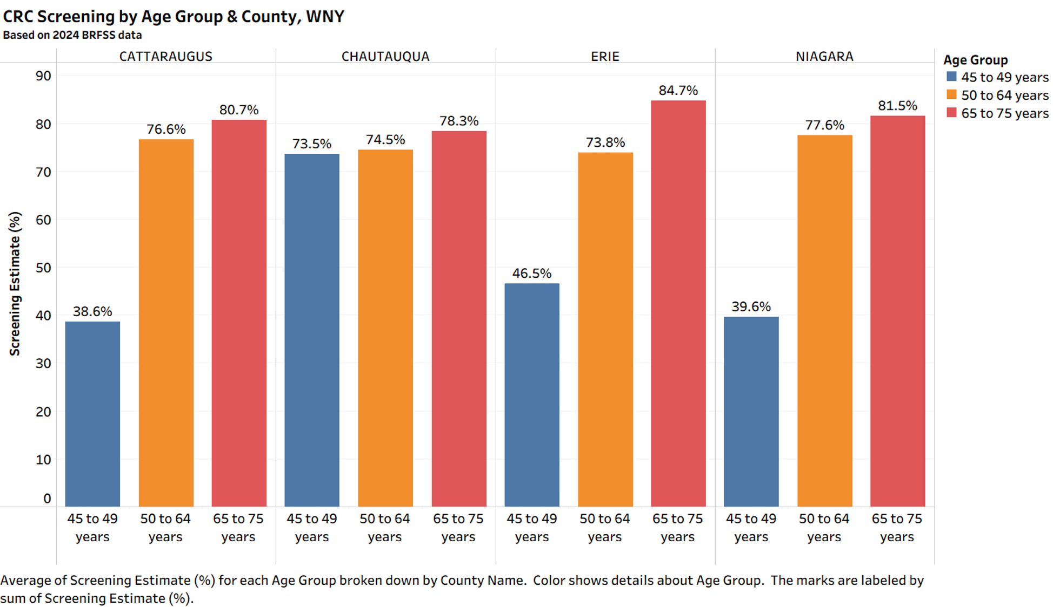

Slide 25
Summary & Key Takeaways
Overall significant improvements made over past 20 years in colorectal cancer screening rates
Gaps remain across race/ethnicity and age
Increasing incidence within <40 year cohort – physicians and public health have opportunities to intervene
  Opportunities to encourage patients with polyps, cancer diagnosis to refer parents, siblings and children for screening
Options available for uninsured/underinsured individuals through ECDOH Cancer Services Program

Slide 26
Early onset colorectal cancer (EOCRC) (Dx < age 50)
01
Why incidence is rising
02
Who and when to screen
Review the leading theories behind increasing rates
Apply current guidelines for average-risk and higher-risk patients
03
Choosing the right test
04
A better colonoscopy experience
Compare colonoscopy, stool-based tests and alternative options
Improve preparation, comfort, safety and follow-through
05
The future of CRC screening
06
Symptoms and cancer-related anxiety
Explore polygenic risk scores and personalized strategies
Evaluate symptoms appropriately while avoiding unnecessary testing
Notes:
Redesigned from the supplied agenda slide. All text remains editable.

Slide 27
Why Is Early-Onset Colorectal Cancer Increasing?
The short answer: we do not know yet.
-Incidence patterns suggest a birth-cohort effect: risk has risen across successive generations.
-Most EOCRC is sporadic; hereditary cancer syndromes do not explain the population-level increase.
-No single dietary, lifestyle, microbial, or environmental exposure has been proven to account for the trend.
-Current thinking favors a multifactorial “exposome” model involving cumulative exposures across the life course.
Changing exposures
Metabolic + microbiome
changes
Inflammation /
epigenetic effects
Carcinogenesis
Disclaimer: These are associations and leading hypotheses. Causality has not been established, and no single exposure has been shown to explain the rise in EOCRC.
References: Akimoto N, et al. Nat Rev Clin Oncol. 2021;18:230–243. Ugai T, et al. Nat Rev Clin Oncol. 2022;19:777–803.
Notes:
A birth cohort effect means that people born during a particular time period carry a different risk of developing a disease than people born in earlier or later generations, even when compared at the same age. The exposome is the totality of environmental and lifestyle exposures a person experiences over their lifetime, beginning as early as conception, and how those exposures interact with biology and genetics to influence health.

Slide 28
Leading Theories: Diet, Metabolism & Lifestyle
Western dietary pattern
Obesity & metabolic dysfunction
Lifestyle
↑ Red & processed meats
↑ Refined carbohydrates / sugar-sweetened beverages
↑ Ultra-processed foods
↓ Fiber and plant-based foods
Childhood & young-adult obesity
Insulin resistance / hyperinsulinemia
Altered IGF signaling & adipokines
Chronic low-grade inflammation
Associated with EOCRC risk—but does not explain the entire trend
Physical inactivity
Sedentary behavior
Alcohol exposure
Tobacco exposure
Disclaimer: Associations do not prove causation; these factors should not be interpreted as established causes of EOCRC.
References: Akimoto N, et al. Nat Rev Clin Oncol. 2021;18:230–243. O’Sullivan DE, et al. Am J Clin Nutr. 2022;115:999–1010. Ugai T, et al. Nat Rev Clin Oncol. 2022;19:777–803.

Slide 29
CRC stage at diagnosis drives mortality
Five-year relative survival falls sharply once colorectal cancer has metastasized
LOCALIZED
REGIONAL
DISTANT
Usually stage I–II
Usually stage II–III
Stage IV
Confined to the colon or rectum
Extension to nearby tissue or nodes
Metastatic disease
91%
75%
17%
5-year relative survival
5-year relative survival
5-year relative survival
≈9% five-year mortality
≈25% five-year mortality
≈83% five-year mortality
EOCRC REALITY
of patients with early-onset CRC presented with stage III–IV disease in a recent multicenter European cohort
≈63%
Survival: SEER 2016–2022. EOCRC: GEOCODE-Europe, 2010–2017. Mortality shown as 100% minus relative survival and is approximate.
Notes:
Sources: National Cancer Institute SEER Cancer Stat Facts: Colorectal Cancer, SEER 21 excluding Illinois, 2016–2022: localized 91.3%, regional 75.2%, distant 16.9% five-year relative survival. https://seer.cancer.gov/statfacts/html/colorect.html
Daca-Alvarez M, et al. Regional patterns of early-onset colorectal cancer from the GEOCODE-European consortium. BJS Open. 2025;9(2):zraf024. Among 851 patients aged 18–49 without inherited CRC syndromes, 62.5% had stage III–IV disease. PMID: 40103402. https://pubmed.ncbi.nlm.nih.gov/40103402/
Note: SEER summary stages do not map exactly to AJCC stages. Mortality values are approximate complements of five-year relative survival, not crude disease-specific mortality.

Slide 30
Current U.S. Colorectal Cancer Average Risk Screening Guidelines
Average-risk, asymptomatic adults
Organization | Publication year | Screening start age
American Cancer Society (ACS) | 2026 | 45
U.S. Preventive Services Task Force (USPSTF) | 2021 | 45
American College of Gastroenterology (ACG) | 2021 | 45
U.S. Multi-Society Task Force (ACG/AGA/ASGE) | 2022 | 45
American College of Physicians (ACP) | 2023 | 50*
ACS, USPSTF, ACG and USMSTF recommend initiation of average-risk CRC screening at age 45.
References: Wolf AMD, et al. CA Cancer J Clin. 2026;76:e70083. • USPSTF. JAMA. 2021;325:1965–1977. • Shaukat A, et al. Am J Gastroenterol. 2021;116:458–479. • Patel SG, et al. Gastroenterology. 2022;162:285–299. • Qaseem A, et al. Ann Intern Med. 2023. *ACP guidance differs for adults age 45–49.

Slide 31
Current U.S. CRC Average Risk Screening Guidelines: Modalities & Intervals
Average-risk, asymptomatic adults
Guideline (year) | Colonoscopy / FIT | Stool molecular | Imaging / endoscopic alternatives | Other
ACS 2026 | Colonoscopy q10 yr FIT annual | mt-sDNA (Cologuard) q3 yr mt-sRNA (Colosense) q3 yr gFOBT annual | CT colonography q5 yr Sigmoidoscopy q5 yr | Blood-based test q3 yr* (non-preferred)
USPSTF 2021 | Colonoscopy q10 yr FIT or HS-gFOBT annual | sDNA-FIT (Cologuard) q1–3 yr | CT colonography q5 yr Sigmoidoscopy q5 yr OR q10 yr + annual FIT | —
ACG 2021 | Colonoscopy q10 yr FIT annual | mt-sDNA (Cologuard) q3 yr | CT colonography q5 yr Sigmoidoscopy q5–10 yr Colon capsule q5 yr | Septin9 not recommended
USMSTF 2017 + 2022 age update | Colonoscopy q10 yr FIT annual | FIT–DNA (Cologuard) q3 yr | CT colonography q5 yr Sigmoidoscopy q5–10 yr Colon capsule q5 yr | Tiered approach; 2022 update changed start age to 45
ACP 2023 | Colonoscopy q10 yr FIT or HS-gFOBT q2 yr | Not recommended | Sigmoidoscopy q10 yr + FIT q2 yr CT colonography not recommended | More restrictive menu of tests
*Positive non-colonoscopy tests require follow-up colonoscopy. ACS 2026 considers blood-based screening non-preferred. USMSTF modality tiers derive from its 2017 comprehensive guideline; the 2022 focused update lowered initiation to age 45.
Refs: Wolf AMD, et al. CA Cancer J Clin. 2026. • USPSTF. JAMA. 2021;325:1965–1977. • Shaukat A, et al. Am J Gastroenterol. 2021;116:458–479. • Rex DK, et al. Gastroenterology. 2017;153:307–323; Patel SG, et al. Gastroenterology. 2022;162:285–299. • Qaseem A, et al. Ann Intern Med. 2023.
Notes:
CRC — Colorectal cancer
FIT — Fecal immunochemical test
HS-gFOBT — High-sensitivity guaiac fecal occult blood test
mt-sDNA — Multitarget stool DNA test
sDNA-FIT — Stool DNA + fecal immunochemical test
mt-sRNA — Multitarget stool RNA test
CTC — CT colonography

Slide 32
Foundation of Average-Risk CRC Screening
Where the major U.S. guidelines largely converge
START
AGE 45
for average-risk adults
COLONOSCOPY
Every 10 years
Prevention + detection
FIT
Every year
Stool-based
COLOGUARD
Every 3 years
mt-sDNA / sDNA-FIT
Any positive non-colonoscopy screening test → diagnostic colonoscopy
Refs: Wolf AMD, et al. CA Cancer J Clin. 2026. • USPSTF. JAMA. 2021;325:1965–1977. • Shaukat A, et al. Am J Gastroenterol. 2021;116:458–479. • Patel SG, et al. Gastroenterology. 2022;162:285–299.

Slide 33
Stool testing – Detection not prevention
Excellent screening options for average-risk patients — but they are primarily cancer-detection tests, not equivalent prevention tests
FIT
Annual
CRC sensitivity
~74%
Advanced adenoma sensitivity
~23%
Polyp removal
No
If positive
Colonoscopy required
COLOGUARD / mt-sDNA
Every 3 years
CRC sensitivity
~93%
Advanced adenoma sensitivity
~43%
Polyp removal
No
If positive
Colonoscopy required
COLONOSCOPY
Every 10 years
CRC sensitivity ~ 99%
Large adenoma detection
~89–95%*
Direct visualization
Entire colon
Polyp removal
Yes — same procedure
Key limitation: stool tests can miss the precursor lesion → colonoscopy can DETECT and REMOVE precancerous polyps in the same examination.
Stool-based screening remains guideline-recommended and effective when performed at the recommended interval with complete follow-up. These figures describe one-time test sensitivity; repeated FIT testing improves programmatic effectiveness. *Colonoscopy sensitivity shown for adenomas ≥10 mm.
Source: USPSTF Evidence Review / Recommendation Statement, JAMA 2021.

Slide 34

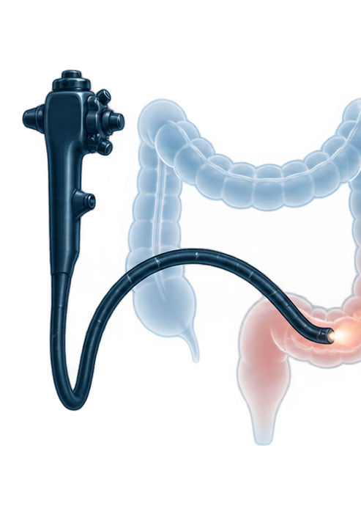


Guideline-supported alternatives
Reserve for selected patients when first-line screening is declined, unavailable, or unsuitable
STRUCTURAL EXAM
LIMITED ENDOSCOPY
CT colonography
Flexible sigmoidoscopy
Whole-colon imaging without sedation. Bowel preparation and insufflation remains necessary.
Directly examines the distal colon. Proximal disease may remain undetected.
CAPSULE IMAGING
BLOOD-BASED SCREENING
Colon capsule endoscopy
Blood-based cell-free DNA
Noninvasive mucosal imaging when colonoscopy is incomplete or unsuitable.
Convenient option with limited sensitivity for advanced precancerous lesions.
Key implication
An abnormal alternative screening test generally requires diagnostic colonoscopy, with bowel preparation and possible polypectomy.
Notes:
The original screenshot listed CT colonography, flexible sigmoidoscopy, capsule colonography, and blood-based cell-free DNA. This redesign uses the term colon capsule endoscopy and emphasizes that abnormal results from non-colonoscopy screening generally require diagnostic colonoscopy. Exact guideline endorsement, interval, and patient eligibility vary among organizations and should be addressed on the corresponding detailed slides.

Slide 35
Alternative Structural Options for CRC Screening
For average-risk patients who are unable or unwilling to undergo colonoscopy or FIT
CT COLONOGRAPHY
Every 5 years
• Entire colon visualized
• Full bowel prep
• No sedation
• Radiation + possible extracolonic findings
• Positive exam → colonoscopy
USPSTF ✓ ACG ✓
COLON CAPSULE
Every 5 years
• Swallowed camera capsule
• Entire colon can be visualized
• Extensive bowel prep
• No sedation / no radiation
• Positive or incomplete exam → colonoscopy
ACG ✓ USPSTF —
FLEXIBLE SIGMOIDOSCOPY
Every 5–10 years*
• Examines distal colon only
• Usually no sedation
• Less invasive than colonoscopy
• RCT evidence of ↓ CRC mortality
• Abnormal exam may → colonoscopy
USPSTF ✓ ACG ✓
*ACG: flexible sigmoidoscopy every 5–10 years. USPSTF: every 5 years, or every 10 years combined with annual FIT.
References: Shaukat A, et al. Am J Gastroenterol. 2021;116:458–479 (ACG). • USPSTF. JAMA. 2021;325:1965–1977. Capsule endoscopy is suggested by ACG as an alternative; USPSTF does not include capsule endoscopy because of limited evidence.

Slide 36
Blood-Based Colorectal Cancer Screening: Shield vs SimpleScreen CRC
FDA-approved blood-based tests for average-risk CRC screening
Characteristic | Shield | SimpleScreen CRC
Manufacturer | Guardant Health | Freenome / commercialized with Abbott
Technology | Cell-free DNA (cfDNA) multimodal genomic/epigenomic signals | Cell-free DNA (cfDNA) single-base methylation signals
FDA approval | 2024 | 2026
CRC sensitivity | 83.1% | 81.1%*
Advanced precancerous lesion sensitivity | 13.2% | 13.7%*
Specificity for advanced neoplasia | 89.6% | 90.4%*
Clinical role | ACS 2026: non-preferred; use if preferred screening is declined/not completed | ACS 2026 evidence review included test; FDA approved after guideline publication
Key limitation: Both detect ~8 in 10 CRCs; only ~13% of advanced precancerous lesions
References: Chung DC, et al. N Engl J Med. 2024;390:973–983 (ECLIPSE). • FDA SimpleScreen CRC SSED, P250029, 2026. • Wolf AMD, et al. CA Cancer J Clin. 2026;76:e70083. *SimpleScreen weighted/prespecified analysis; FDA unweighted pivotal estimates: CRC 79.2%, APL 12.5%, specificity 91.5%.

Slide 37
High-risk CRC screening
Consensus across ACG, USMSTF (AGA/ACG/ASGE), AGA CPU and NCCN guidance
HIGH-RISK CRITERIA
First-degree relative (FDR) with CRC or an advanced polyp – START AT 40
SCREENING APPROACH
WHAT COUNTS AS AN
FDR diagnosed before age 60, or ≥2 affected FDRs
ADVANCED POLYP?
COLONOSCOPY
Adenoma or sessile serrated lesion ≥10 mm, villous/tubulovillous histology, or high-grade dysplasia
at age 40 or 10 years before the youngest diagnosis
Whichever comes first. Repeat every 5 years.
One FDR diagnosed at age 60 or older
WHERE GUIDELINES DIFFER
Begin at age 40, then use average-risk modalities and intervals
AGA 2023
Any FDR with CRC is increased risk; colonoscopy favored every 5 years.
ACG / USMSTF
Age 60 and number of affected FDRs determine intensity. One FDR ≥60 may transition to average-risk options.
Key distinction: family history of an advanced polyp carries the same screening implications as family history of CRC.
USPSTF / ACS
Primarily average-risk guidance, not the main source for high-risk screening.
Refs: Shaukat et al., ACG 2021 • USMSTF 2017 • Issaka et al., AGA CPU 2023 • NCCN family-history guidance summarized in AGA CPU 2023
Notes:
Content preserved from the supplied reference slide. Sources listed on-slide: Shaukat et al., ACG 2021; USMSTF 2017; Issaka et al., AGA Clinical Practice Update 2023; NCCN family-history guidance summarized in the AGA CPU 2023.

Slide 38
Cases I still think about
44-year-old female no PMH
The missed opportunity
No prior screening test
Unrecognized high-risk status
Presented with rectal bleeding
Colonoscopy: rectosigmoid mass
Only after her cancer diagnosis did she learn a FDR had high-risk (advanced) polyps—a history that could have triggered screening colonoscopy at age 40.
Staging: metastatic (Stage IV) CRC
After diagnosis: Patient learned of FDR with history risk (advanced) polyps

Slide 39
Cases I still think about
62-year-old woman
The missed opportunity
Followed with Cologuard every 3 years from ~ age 50. Cologuard 1 year ago was negative
Inappropriate screening modality
Presented with rectal bleeding
Colonoscopy: rectosigmoid mass, multiple other advanced polyps
Stool based screening was inappropriate given her high-risk status.
Staging: Stage III CRC
FDR with history of CRC at age ~74

Slide 40
Colonoscopy surveillance after polyp removal
Average-risk adults after a high-quality exam and complete resection
10 years
Normal exam or only hyperplastic polyps <10 mm in the rectum/sigmoid
7–10 years
1–2 tubular adenomas <10 mm
5–10 years
1–2 sessile serrated polyps <10 mm
3–5 years
3–4 tubular adenomas <10 mm, or 3–4 sessile serrated polyps <10 mm
3 years
5–10 adenomas; any adenoma ≥10 mm, villous histology, or high-grade dysplasia; 5–10 SSPs, any SSP ≥10 mm, SSP with dysplasia, or traditional serrated adenoma
1 year
>10 adenomas on one exam; consider genetic evaluation
6 months
Piecemeal resection of an adenoma or SSP >20 mm
Source: U.S. Multi-Society Task Force, 2020
Notes:
Source: Gupta S, et al. Recommendations for Follow-Up After Colonoscopy and Polypectomy: A Consensus Update by the US Multi-Society Task Force on Colorectal Cancer. Gastroenterology. 2020;158:1131-1153. https://doi.org/10.1053/j.gastro.2019.10.026

Slide 41
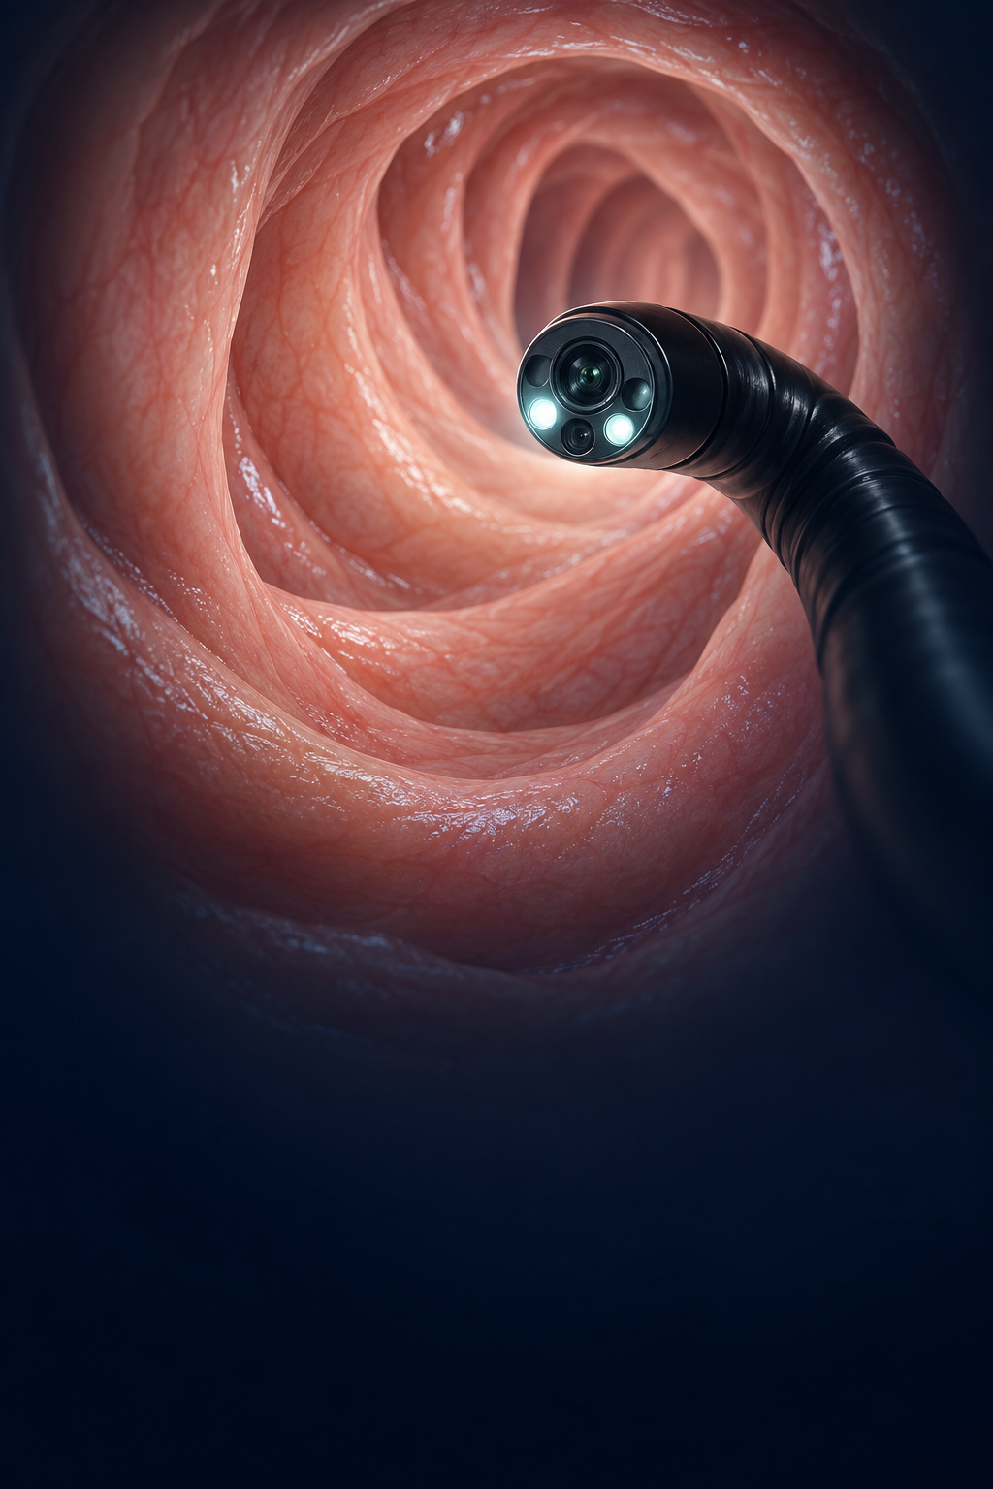
COLONOSCOPY
Better detection.
Safer resection.
Easier recovery.
Five practical advances shaping modern colonoscopy
01
Bowel preparation
Split-dose strategies and tolerability
02
AI-assisted detection
GI Genius and ADR / SSLDR benchmarks
03
CO₂ insufflation
Recovery comfort and procedural safety
04
Sedation strategy
MAC versus moderate sedation
05
Advanced polypectomy
EMR and contemporary resection techniques
Modern colonoscopy
Quality, comfort, and advanced therapy
Illustration: AI-generated medical schematic
Notes:
Section overview: bowel preparation, AI-assisted detection and quality metrics, carbon dioxide insufflation, sedation strategy, and advanced polypectomy. The original source was a supplied screenshot; this slide recreates the content as editable PowerPoint elements.

Slide 42
Bowel Prep Options: What Does the Patient Actually Have to Drink?
Antiemetics optional
Medication volume varies widely — total hydration requirements often do not.
LARGE-VOLUME
PRESCRIPTION PEG
MIRALAX
REGIMEN
SMALL-VOLUME /
CONCENTRATED
SUTAB
TABLETS
~128 oz
4-L PEG-electrolyte solution
(e.g., GoLYTELY-type)
238 g PEG 3350 mixed in
64 oz clear sports drink*
+/- stimulant laxative tablets
e.g., SUPREP, Clenpiq, Moviprep: two 6-oz bottles
Diluted before drinking
12 tablets × 2 doses
24 tablets
64 oz
12 oz concentrate; 32 oz with dilution
Medication / mixed prep volume
Medication / mixed prep volume
Medication / mixed prep volume
Tablets + required water
Often additional clear liquids
Additional clear liquids encouraged
≈96 oz total (64 oz of additional required water)
≈96 oz total of water required
Visual scale above compares PREP/MEDICATION volume. “Low-volume” does not mean low total fluid intake: concentrated preps and SUTAB still require substantial water.
*MiraLAX-based bowel preparation is commonly used but is not an FDA-approved PEG-electrolyte bowel-prep product. Exact instructions vary by regimen/product; follow the prescribed split-dose protocol.

Slide 43
Why “Split-Dose” Bowel Preparation Works Better
The key is not just WHAT the patient drinks — it is WHEN the final dose reaches the colon
SPLIT-DOSE TECHNIQUE
EVENING BEFORE
MORNING OF PROCEDURE
COLONOSCOPY
½ of prep
Remaining ½
Clean colon
Clears the bulk
of stool
Flushes material
that accumulates overnight
Better visualization
→ better lesion detection
Best cleansing occurs when the LAST DOSE is completed ~2–5 hours before colonoscopy
WHY IT MATTERS
CLEANER COLON
Higher-quality bowel cleansing
BETTER ADR
Improved adenoma detection
FEWER REPEATS
Less inadequate prep / fewer early repeat exams
BETTER TOLERATED
Less volume consumed all at once
Key concept: the longer the interval between finishing the prep and colonoscopy, the more intestinal secretions and debris can accumulate.
Refs: US Multi-Society Task Force on CRC. Gastroenterology. 2025;169:217–244. • Martel M, et al. Gastroenterology. 2015;149:79–88. • Bucci C, et al. Gastrointest Endosc. 2014;80:566–576.

Slide 44
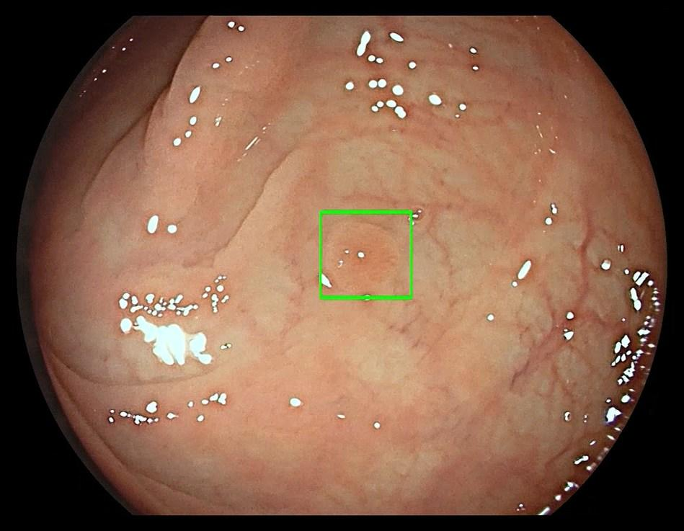
GI Genius™: AI-Assisted Polyp Detection
A real-time “second observer” during colonoscopy
WHAT IT DOES
  Analyzes the live white-light colonoscopy video frame-by-frame.
WHAT THE ENDOSCOPIST SEES
  A visual marker appears over a region suspicious for a mucosal lesion.
WHAT IT DOES NOT DO
  It does not replace the endoscopist, pathology, or clinical decision-making.
WHY IT MATTERS
  Improves Adenoma Detection Rate (ADR) up to 10%
AI ALERT
Illustrative recreation of the on-screen detection marker; not an actual patient image. Source: Medtronic GI Genius indications / FDA-cleared use.

Slide 45
Adenoma and sessile serrated lesion detection rate
ADR predicts outcomes; SSLDR adds a distinct measure of serrated-pathway detection
OUTCOME EVIDENCE FOR ADR
ADENOMA DETECTION RATE
SESSILE SERRATED LESION
DETECTION RATE
For each 1-point increase
ADR
SSLDR
≈ 3% lower
≥35%
≥6%
post-colonoscopy / interval CRC risk
minimum performance target
minimum performance target
≈ 5% lower
Practice aspiration
fatal interval CRC risk
≥50% overall ADR
Track separately from ADR
Association derived from continuous hazard ratios
Flat, subtle proximal lesions may be missed despite an acceptable ADR
Takeaway
Track both metrics: ADR measures conventional adenoma detection, while SSLDR addresses an important serrated-pathway blind spot.
Corley et al., NEJM 2014; Rex et al., Gastrointest Endosc 2024. ADR target ≥35%; SSLDR target ≥6%.
Notes:
ADR outcome data: Corley DA, et al. Adenoma Detection Rate and Risk of Colorectal Cancer and Death. N Engl J Med. 2014;370:1298-1306. The reported approximate 3% and 5% reductions correspond to HR 0.97 for interval CRC and HR 0.95 for fatal interval CRC per 1-percentage-point ADR increase and represent associations, not trial-proven causal effects. Quality targets: Rex DK, Anderson JC, Butterly LF, et al. Quality indicators for colonoscopy. Gastrointest Endosc. 2024;100(3):352-381. doi:10.1016/j.gie.2024.04.2905. Minimum performance targets: overall ADR ≥35% and SSLDR ≥6%. The ≥50% ADR statement is presented as a practice aspiration rather than the formal minimum target.

Slide 46
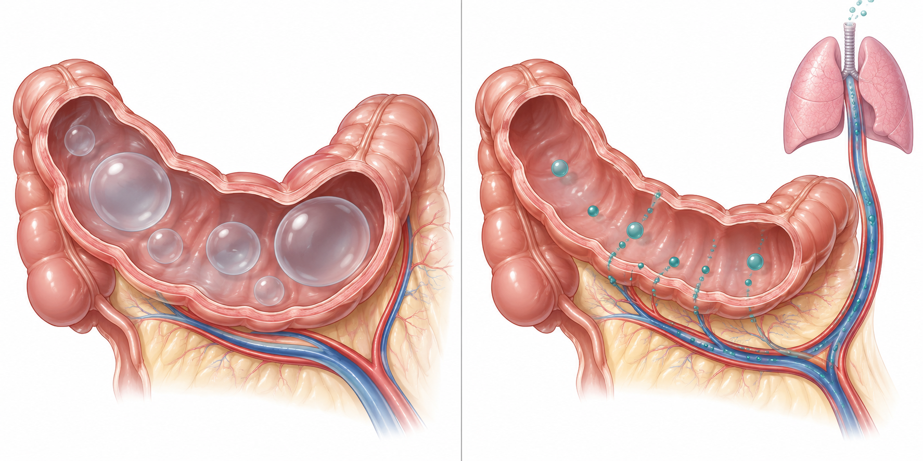
CO₂ insufflation improves recovery after colonoscopy
Rapid absorption means less retained gas, pain, and bloating after the procedure
ROOM AIR
CO₂
What changes for the patient
COMFORT
Less abdominal pain and cramping during early recovery
Less bloating and visible distension after discharge
SAFETY
Rapid clearance limits prolonged luminal distension and barotrauma
Gas persists and distends the bowel
Absorbed through mucosa and exhaled
Clinical takeaway
CO₂ provides the greatest benefit after longer or therapeutic procedures. Trials show improved comfort without an increase in routine cardiopulmonary adverse events.
Use appropriate monitoring in patients at risk for CO₂ retention.
Notes:
CO₂ crosses the gastrointestinal mucosa rapidly, enters the circulation, and is eliminated through the lungs. Randomized trials and systematic reviews consistently show less post-procedure abdominal pain and bloating than room-air insufflation, with no meaningful increase in cardiopulmonary adverse events in routine endoscopy. Rapid absorption may also reduce the consequences of extraluminal gas during perforation, although it does not prevent perforation itself. Use appropriate monitoring and clinical judgment in patients with severe pulmonary disease or known CO₂ retention. Sources: ASGE Technology Committee. The use of carbon dioxide in gastrointestinal endoscopy. Gastrointest Endosc. 2016;83:857-865. https://www.asge.org/home/resources/publications/tech-assessments/2016_co2_gi_endoscopy. Paspatis GA, et al. ESGE Position Statement on iatrogenic endoscopic perforations. Endoscopy. 2020. https://www.esge.com/assets/downloads/pdfs/guidelines/2020_a_1222_3191.pdf

Slide 47
Sedation for Endoscopy: MAC vs Moderate Sedation
Both are effective — the major differences are depth, medications, personnel, recovery and cost
FEATURE
MODERATE SEDATION
MAC / PROPOFOL-BASED SEDATION
Typical drugs
Midazolam + fentanyl
Propofol
Sedation depth
Moderate: purposeful response
to verbal/tactile stimulation
Often deep sedation: response only
to repeated/painful stimulation
Who administers
Endoscopy team under
endoscopist supervision*
Anesthesia professional
Onset / recovery
Slower onset; recovery may
be somewhat longer; N/V
Rapid onset and generally
faster recovery; no N/V
Patient experience
Potential for discomfort
Less awareness/recall;
very high patient satisfaction
Airway / breathing
Spontaneous ventilation
usually maintained
Greater potential for apnea /
airway intervention with deep sedation
Cost / resources
Lower cost; no separate
anesthesia professional
Higher cost / resource use

Slide 48
Colonoscopy safety
Population data show declining post-colonoscopy bleeding; perforation was already rare and has generally remained low/stable.
POST-COLONOSCOPY BLEEDING
PERFORATION
Population-based meta-analysis, 2001–2015
Rare throughout modern practice
6.4/1,000
~0.5
0.6
0.4
per 1,000
/1,000
2008–12
/1,000
2013–17
1.0/1,000
pooled overall rate
(2001–2015)
Earlier studies
Later studies
≈84% lower reported bleeding rate across the study era
SPLENIC INJURY — very rare, but potentially serious
Outpatient data (1.44M colonoscopies): 3.19 per 100,000 ≈ 1 in 31,400 • 63% diagnosed within 48 h • 41% required surgery
WHAT HAS CHANGED?
Cold snare
less electrocautery for small polyps
Technique
better resection + hemostasis strategies
CO2 insufflation
Quality
training, volume & standardized metrics
Technology
high-definition imaging + modern devices
Refs: Reumkens A, et al. Am J Gastroenterol. 2016;111:1092–1101. • Wang L, et al. World J Gastroenterol. 2019;25:190–204. • Rabeneck L, et al. Endosc Int Open. 2021;9:E1221–E1229. • US Multi-Society Task Force. Gastroenterology. 2020;158:1095–1129.

Slide 49
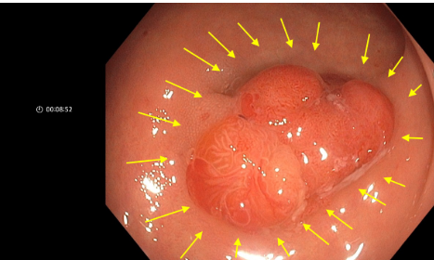
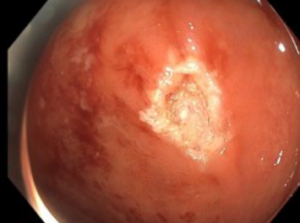
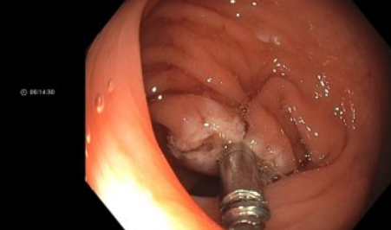
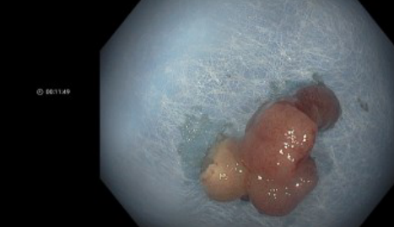
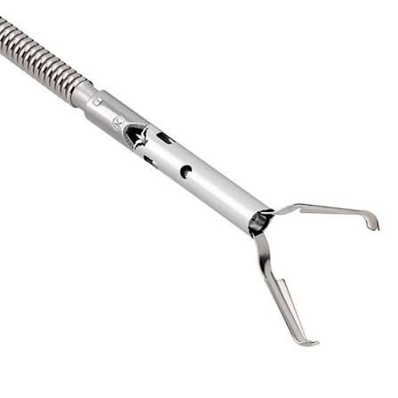

Slide 50
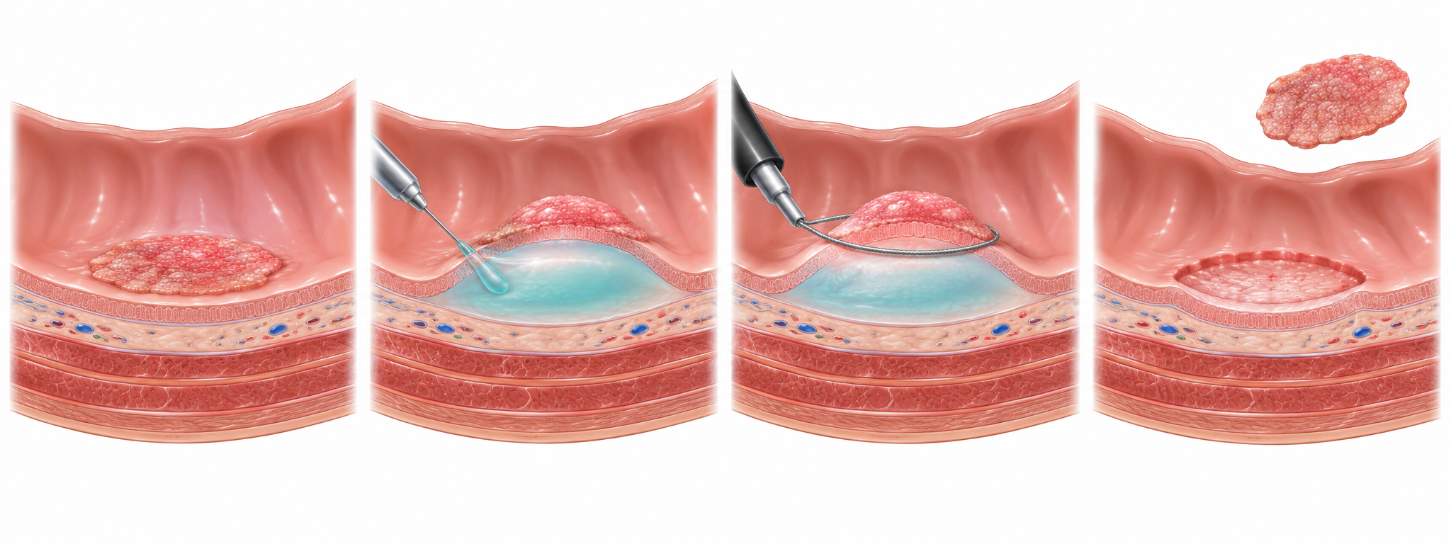
Endoscopic mucosal resection (EMR)
Organ-preserving removal of superficial GI neoplasia
Clinical role
BEST FOR
Large sessile or laterally spreading lesions without features of deep invasion
WHY EMR
Potentially curative, provides histology, and can avoid surgical resection
LIMITS
Larger lesions often require piecemeal resection, which increases local recurrence risk
MAIN RISKS
1
Identify
2
Inject + lift
3
Snare resection
4
Retrieve + inspect
Bleeding, perforation, post-polypectomy syndrome, and residual or recurrent adenoma
Key practice point
Refer ≥20 mm nonpedunculated colorectal lesions to an endoscopist experienced in advanced resection. After piecemeal EMR of a lesion ≥20 mm, first surveillance is generally at 6 months.
Notes:
EMR removes superficial neoplasia by lifting the lesion into the submucosal space and capturing it with a snare. The U.S. Multi-Society Task Force recommends EMR as the preferred treatment for large (≥20 mm) nonpedunculated colorectal lesions and recommends the first surveillance colonoscopy at approximately 6 months after piecemeal EMR of lesions ≥20 mm. Source: Kaltenbach T, et al. Endoscopic Removal of Colorectal Lesions. Gastroenterology. 2020;158:1095-1129. doi:10.1053/j.gastro.2019.12.018.

Slide 51
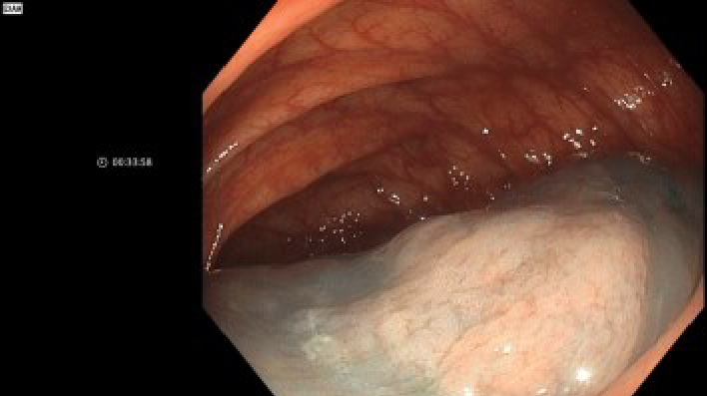
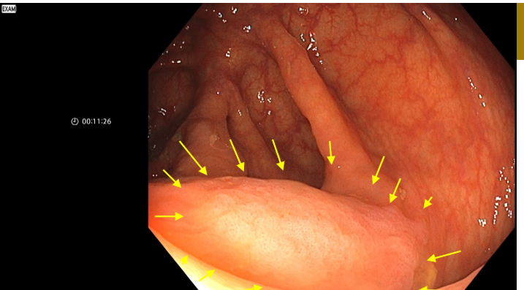
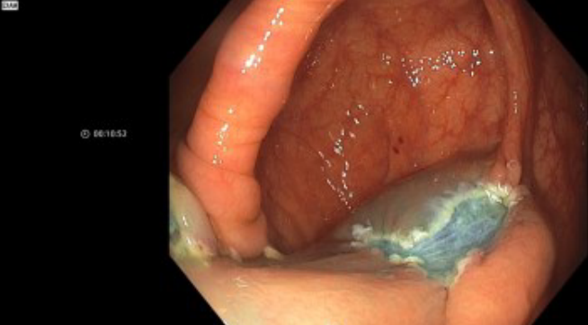

Slide 52

Polygenic risk scores for colorectal cancer - the future of screening?
Hundreds to millions of common variants
One stable score
Part of a broader risk model
Each variant has a small effect. The score weights and combines those effects into a relative risk estimate.
DNA does not change with age, so a PRS can inform lifetime risk before screening begins.
Age, sex, family history, lifestyle and prior findings still matter. PRS does not replace testing for Lynch syndrome or polyposis.
The intended output is a risk percentile or absolute risk estimate, not a diagnosis.
In a 2026 Danish cohort, people with high PRS reached the CRC incidence of low-PRS groups up to 10 years earlier between ages 45 and 60.
Sources: CDC Genomics and Precision Health; Thomas et al., Am J Hum Genet 2020
1
Notes:
Sources: Thomas M, et al. Genome-wide modeling of polygenic risk score in colorectal cancer risk. Am J Hum Genet. 2020;107:432-444. CDC Genomics and Precision Health: Should polygenic risk scores be used in risk-stratified colorectal cancer screening? 2020.

Slide 53
Promising signal, limited clinical utility so far
Risk discrimination alone does not prove that PRS-guided screening improves outcomes
WHAT THE EVIDENCE SUPPORTS
WHAT REMAINS UNPROVEN
PRS consistently separates groups with different lifetime risks of adenoma and colorectal cancer.
Recent data found little added value when PRS was combined with FIT to predict advanced neoplasia or CRC.
The score may identify people who reach a clinically important risk threshold years earlier than others.
Thresholds, screening intervals and benefits must be validated prospectively across diverse ancestry groups.
Combining PRS with age and clinical factors performs better than genetics alone.
Cost, access, privacy and the risk of widening disparities remain important implementation questions.
Current role: research and risk-model development, not routine U.S. colorectal cancer screening
Sources: Briggs et al., BMJ 2022; Tamlander et al., Br J Cancer 2024; Nøhr et al., Br J Cancer 2026
3
Notes:
Sources: Briggs SEW, et al. Integrating genome-wide polygenic risk scores and non-genetic risk to predict colorectal cancer diagnosis using UK Biobank data. BMJ. 2022;379:e071707. Tamlander M, et al. Genome-wide polygenic risk scores for colorectal cancer have implications for risk-based screening. Br J Cancer. 2024;130:651-659. Nøhr AK, et al. Br J Cancer. 2026. The statement on current role reflects that major U.S. screening recommendations remain age, family-history and syndrome based rather than PRS based.

Slide 54
A plausible future screening pathway
PRS may guide who receives colonoscopy first, while FIT and colonoscopy remain the screening tests
01
02
03
04
05
ONE-TIME GENETIC DATA
ABSOLUTE RISK MODEL
SCREENING PLAN
TEST RESULT
ADAPT OVER TIME
Calculate PRS before the usual screening age.
Combine PRS with age, sex, family history and modifiable risks.
Choose starting age, modality and interval according to risk.
Use FIT, colonoscopy or another validated screening test.
Update clinical factors and prior findings. The PRS stays constant.
Before implementation
Prospective trials must show fewer cancers or deaths, safe de-intensification for lower-risk groups, equitable performance, and acceptable cost.
Most likely near-term use: selecting an earlier start for a small high-risk group, not replacing colonoscopy or FIT.
Synthesis based on current risk-stratification studies and U.S. screening practice
4
Notes:
This slide presents a forward-looking synthesis, not a current guideline. Supporting sources: Jeon J, et al. Gastroenterology. 2018;154:2152-2164; Briggs SEW, et al. BMJ. 2022;379:e071707; Nøhr AK, et al. Br J Cancer. 2026.

Slide 55
Cancer related anxiety: Social media is shaping the EOCRC Conversation
What patients see online can influence how they interpret symptoms—and when they seek care.
85
most-liked Tik-tok videos
→
>37M
total views
about young-onset colorectal cancer
a major source of awareness
PHYSICIAN-CREATED CONTENT
PATIENT / NON-PHYSICIAN CONTENT
Higher-quality information
More views and engagement
More medically accurate and educational, less views
Personal stories often travel farther
Patients may hear about EOCRC on social media before they hear about it from us.
Our role: validate appropriate concern, correct misinformation, recognize alarm symptoms, and avoid dismissing risk because a patient is young.
Ayer D, Jain A, Singh M, et al. Understanding TikTok’s Role in Young-Onset Colorectal Cancer Awareness and Education. 2025. doi:10.1007/s13187-025-02585-3.

Slide 56

Tanner Martin • @tannerandshay
A personal cancer journey that culminated in one of the most widely viewed EOCRC posts.
TikTok + Instagram
>8M
TikTok views on his final prerecorded video
THE STORY
Diagnosed with stage IV colon cancer at age 25. In his final prerecorded post, Tanner opened with the message that if viewers were watching it, he had died.
WHY IT MATTERS
Personal storytelling turned a young patient’s cancer experience into a message seen by millions—far beyond a traditional health campaign.
Tanner and Shay Wright with their daughter AmyLou. Photo credit shown in source image: The Nightly.
Reach: Khaleej Times, June 2025 (>8M TikTok; >3M Instagram).

Slide 57
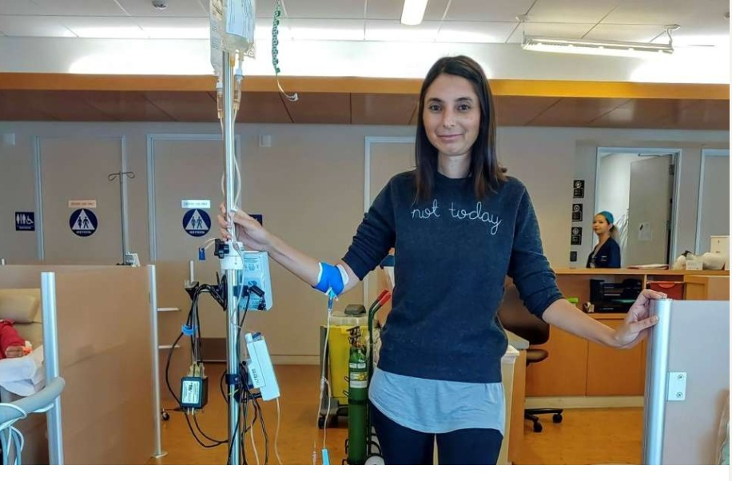
Elizabeth Wachsberg • @mystage4story
Daily TikTok advocacy after a stage IV diagnosis at age 38.
TikTok
2.4M
views on a single CRC-awareness TikTok
THE STORY
Diagnosed with stage IV colon cancer at 38. Her posts cover symptoms, chemotherapy, screening, research, and questions from younger adults worried about CRC.
WHY IT MATTERS
High-engagement patient education can increase awareness—but it also means PCPs increasingly see patients whose risk perception is shaped by social media.
Elizabeth Wachsberg during her third round of chemotherapy for colon cancer. Photo courtesy of Elizabeth Wachsberg.
Reach/caption details: UCLA Health, Apr 26, 2023.

Slide 58
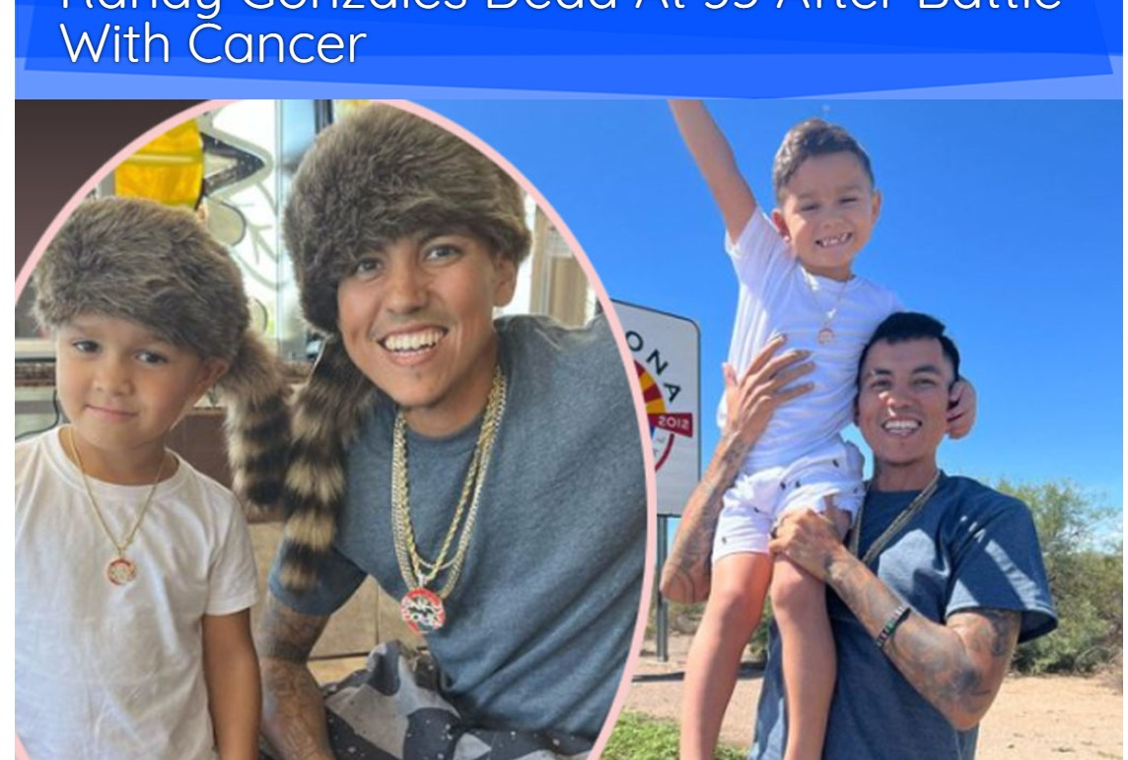
Randy Gonzalez • Enkyboys
A massive pre-existing TikTok audience became a platform for colon-cancer awareness.
TikTok / Instagram
>15M
TikTok followers when he disclosed his diagnosis
THE STORY
Diagnosed with stage IV colon cancer in his early 30s after years of intermittent abdominal pain. He publicly urged young people to take symptoms seriously and get evaluated.
WHY IT MATTERS
Blind spot: a young patient with persistent symptoms may not fit the screening age, or even typical alarm symptoms
Randy Gonzalez and his son Brice; headline reports his death at 35 after cancer.
Audience/diagnosis: Fort Worth Star-Telegram, Apr 14, 2022; ABC News, Jan 27, 2023.

Slide 59
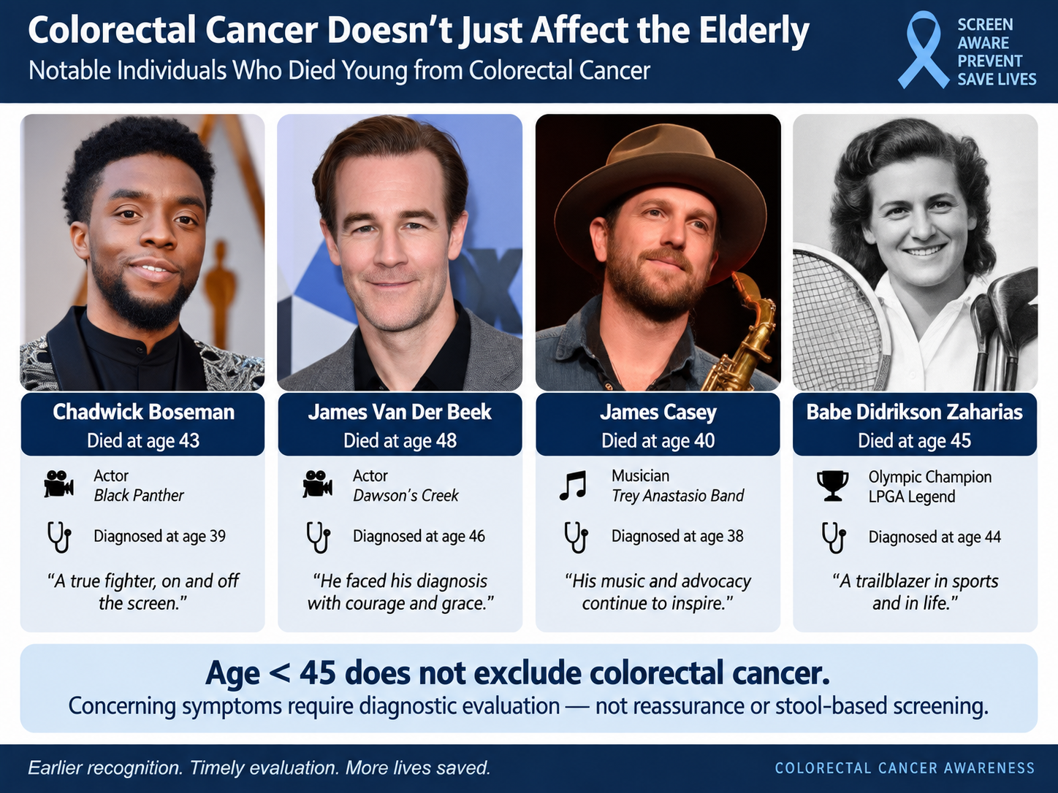

Slide 60
Symptomatic patient who do not qualify for screening
1. Recognize
alarm symptoms
• Rectal bleeding, melena, iron-deficiency anemia, unintentional weight loss
• Without alarm features, start with appropriate non-invasive evaluation
• Re-evaluate patients even when symptoms are without alarm features
• Reassure only when symptoms resolve
• Non-specific symptoms that persist should not be ignored simply due to age
2. Follow up!
3. GI consultation
• Consider GI consultation if there is uncertainty
• Partner on diagnostic strategy and patient counseling
4. Responsible use of
colonoscopy
• Use shared decision-making; patient concerns and clinical context matter
Early recognition and timely evaluation can save lives.

Slide 61
Cases I still think about
44-year-old woman
The missed opportunity
No prior screening test
Unrecognized high-risk status
Presented with rectal bleeding
Colonoscopy: rectosigmoid mass
Only after her cancer diagnosis did she learn a FDR had high-risk (advanced) polyps—a history that could have triggered screening colonoscopy at age 40.
Staging: metastatic (Stage IV) CRC
After diagnosis: Patient learned of FDR with history risk (advanced) polyps

Slide 62



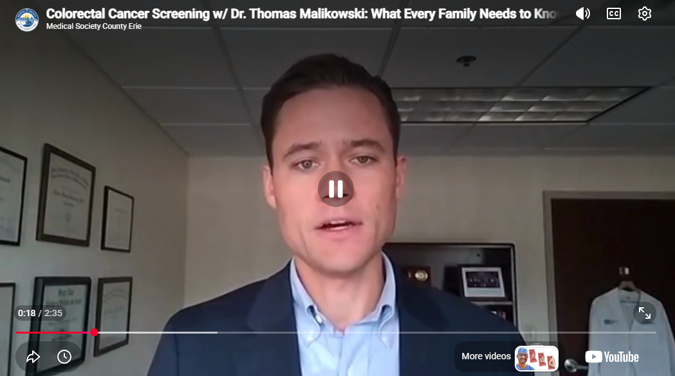
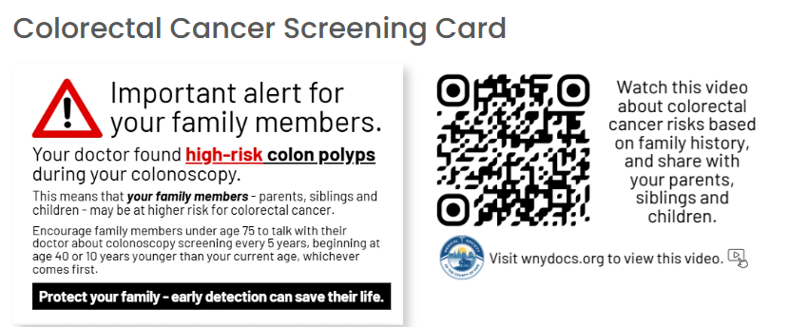
Medical Society of the County of Erie
Educational Outreach
wnydocs.org/CRC-awareness

Slide 63

Erie County Cancer Services Program
Free breast, cervical and colorectal cancer screenings for people who are uninsured and underinsured.
Stool-based tests (FIT kit) for average risk individuals
Colonoscopy for those at increased risk
Call 716-858-7376

Slide 64

TAKE-HOME
POINTS
Three actions that change outcomes
Prevention depends on timely screening and prompt evaluation of symptoms
Colorectal cancer prevention
Colorectal cancer remains highly preventable
01
Screening and polypectomy can interrupt progression, even as early-onset colorectal cancer continues to rise.
Screen at the right time with the right test
02
Begin average-risk screening at age 45. Patients with family history or other high-risk features may need colonoscopy by age 40 or earlier.
Thomas Malikowski, MD
Act on concerning symptoms at any age
03
Tmalikowski@gastrowny.com
Rectal bleeding, iron-deficiency anemia, persistent bowel changes, or unexplained weight loss warrant timely diagnostic evaluation.
Cell 716-785-1738
EPIC secure chat: Thomas Malikowski
EOCRC = early-onset colorectal cancer
Notes:
Closing slide. Key messages: colorectal cancer is highly preventable; average-risk screening begins at age 45; higher-risk patients may need colonoscopy by age 40 or earlier depending on family history and syndrome-specific recommendations; symptoms require diagnostic evaluation regardless of age. Contact information is reproduced from the supplied source slide.

